Slide 1
HR Analytics
Predictive analytics using Decision tree classifier
By Rekha Kesavan

Slide 2
INTRODUCTION
Employee attrition has become a major area of concern for organizations in the current dynamic business scenario. After having spent huge investment of time and money on employees on their training, organizations are still finding it challenge to control the attrition rate. It is the responsibility of the management and the human resource team not only to take efforts to retain the employee but also to find out the exact reasons leading to the decision. Lucrative monetary offers, employee perks, flexible timings and next gen work ambience, growth opportunities etc. are some of the common factors which prompt an employee to look for a change. For example, as per KPMG survey ,“better career opportunities” is a top factor for attrition. But these factors change across organizations.

Slide 3
OBJECTIVE
The differentiating factor lies in how organizations are able to accurately predict the reasons for attrition and close the gap between organization policies and employee’s aspirations. Hence the objective of this paper is to analyze the existing employee attrition data set and Decision Tree model to predict attrition. The top factors having an impact on employee attrition will be identified for the organization to take action on data derived insights.

Slide 4
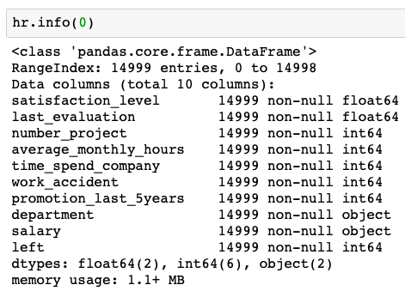
Dataset
Data set contains around 15000 employees. Each row represents an employee; each column contains employee attributes:
* satisfaction_level (0–1) * last_evaluation (Time since last evaluation in years) * number_projects (Number of projects completed while at work) * average_monthly_hours (Average monthly hours at workplace) * time_spend_company (Time spent at the company in years) * Work_accident (Whether the employee had a workplace accident) * left (Whether the employee left the workplace or not (1 or 0)) * promotion_last_5years (Whether the employee was promoted in the last five years) * sales (Department in which they work for) * salary (Relative level of salary)
https://github.com/akjadon/Finalprojects_DS/blob/master/Employee-Attrition/data/employee-attrition.csv

Slide 5
Analytic Technique
For each observation of the predictor measurement there is an associated response measurement in the dataset which indicates that predicting model needs to be built using supervised learning algorithm. The response/outcome variable is qualitative in nature and so predicting a qualitative response for an observation would require classification technique. In this project, I would use Decision Tree (CART) classifying technique from supervised learning to build a machine learning model which will accurately predict the outcome variable which is whether employee will leave the organization or not.

Slide 6

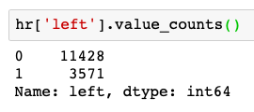
Data Exploration
There are 14999 observations with 10 variables. Out of these 10 variables, one is the outcome variable “Left”. Of the remaining 9 variables 2 are of categorical nature and have values from a defined dataset. The remaining 7 variables are Integer and float types.
The “left” column is the outcome variable recording 1 and 0. 1 for employees who left the company and 0 for those who didn’t.
There is no missing values in the given dataset.
There are 3571 employees left [0] and 11428 employees stayed in [1] our data.
The average satisfaction level of employees who stayed with the company is higher than that of the employees who left.
The average monthly work hours of employees who left the company is more than that of the employees who stayed.

Slide 7
Data Exploration
The employees who had workplace accidents are less likely to leave than that of the employee who did not have workplace accidents.
The employees who were promoted in the last five years are less likely to leave than those who did not get a promotion in the last five years.
Based on bar chart,
It is evident that the frequency of employee turnover depends a great deal on the department they work for. The department can be a good predictor of the outcome variable.
The proportion of the employee turnover depends a great deal on their salary level. The salary level can be a good predictor in predicting the outcome.

Slide 8
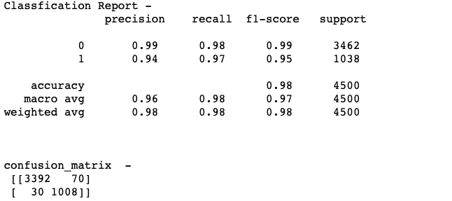

Decision Tree Classifier
The Dataset is split into Training and Test data set in the ratio of 70:30. The model is trained used training dataset. The prediction is done using test dataset. The confusion matrix to visualize predictions made by a classifier and the accuracy of a classification is shown below.
The model predicted an employee is going to leave, that employee actually left 93% of the time

Slide 9
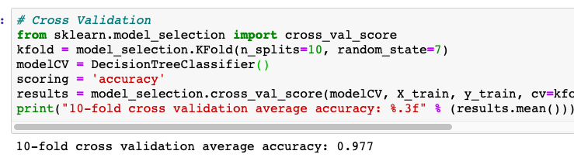
Decision Tree Classifier
Cross validation is attempted to avoid overfitting while still producing a prediction for each observation dataset. 10-fold Cross-Validation is used to train our decision tree classifier model.
The average accuracy remains very close to the decision tree model accuracy; hence, we can conclude that the model generalizes well.

Slide 10
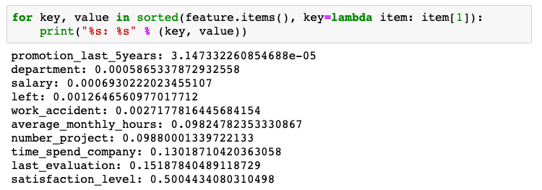
Top factors
The top 3 factors associated with attrition of employee in an organization for the given data set are
Satisfaction level
Last evaluation
Time Spent with company

